Slide 1
Chapter 2 Getting Started
Chi-Yeh Chen
陳奇業
成功大學資訊工程學系

Slide 2
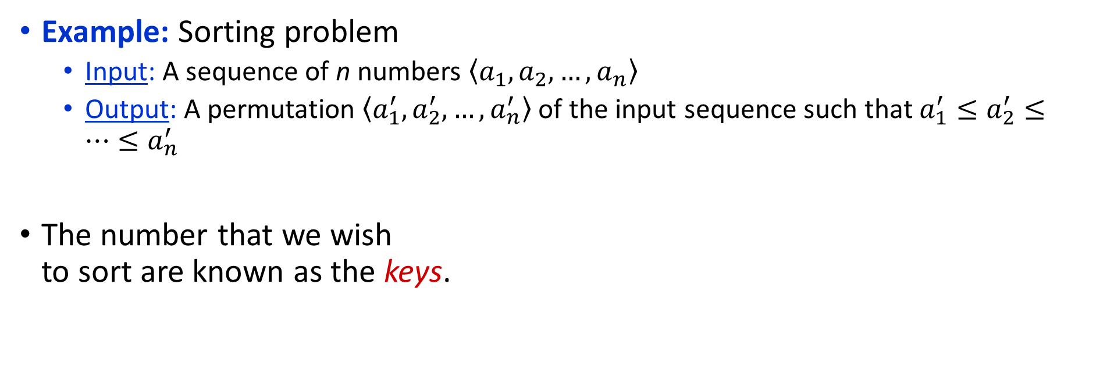
2.1 Insertion sort
Example: Sorting problem
Input: A sequence of n numbers $\left\langle a_{1},a_{2},…,a_{n}\right\rangle$
Output: A permutation $\left\langle a_{1}^{′},a_{2}^{′},…,a_{n}^{′}\right\rangle$ of the input sequence such that $a_{1}^{′}≤a_{2}^{′}≤…≤a_{n}^{′}$
The number that we wish to sort are known as the keys.

Slide 3
Pseudocode
Insertion sort
Insertion-sort(A)
for j ← 2 to length[A]
do key ← A[j]
*Insert A[j] into the sorted sequence A[1,…, j – 1]
i ← j – 1
while i > 0 and A[i] > key
do A[i + 1] ← A[i]
i ← i – 1
A[i + 1] ← key

Slide 4




The operation of Insertion-Sort
1 | 2 | 3 | 4 | 5 | 6
5 | 2 | 4 | 6 | 1 | 3
1 | 2 | 3 | 4 | 5 | 6
2 | 5 | 4 | 6 | 1 | 3
(a)
(b)
1 | 2 | 3 | 4 | 5 | 6
2 | 4 | 5 | 6 | 1 | 3
1 | 2 | 3 | 4 | 5 | 6
2 | 4 | 5 | 6 | 1 | 3
(c)
(d)
1 | 2 | 3 | 4 | 5 | 6
1 | 2 | 4 | 5 | 6 | 3
1 | 2 | 3 | 4 | 5 | 6
1 | 2 | 3 | 4 | 5 | 6
(e)
(f)

Slide 5
Sorted in place:
The numbers are rearranged within the array A, with at most a constant number of them sorted outside the array at any time.
Loop invariant:
At the start of each iteration of the for loop of line 1-8, the subarray A[1,…, j – 1] consists of the elements originally in A[1,…, j – 1] but in sorted order.

Slide 6
We use loop invariants to help us understand why an algorithm is correct. We must show three things about a loop invariant:
Initialization: It is true prior to the first iteration of the loop.
Maintenance: If it is true before an iteration of the loop, it remains true before the next iteration.
Termination: When the loop terminates, the invariant gives us a useful property that helps show that the algorithm is correct.

Slide 7
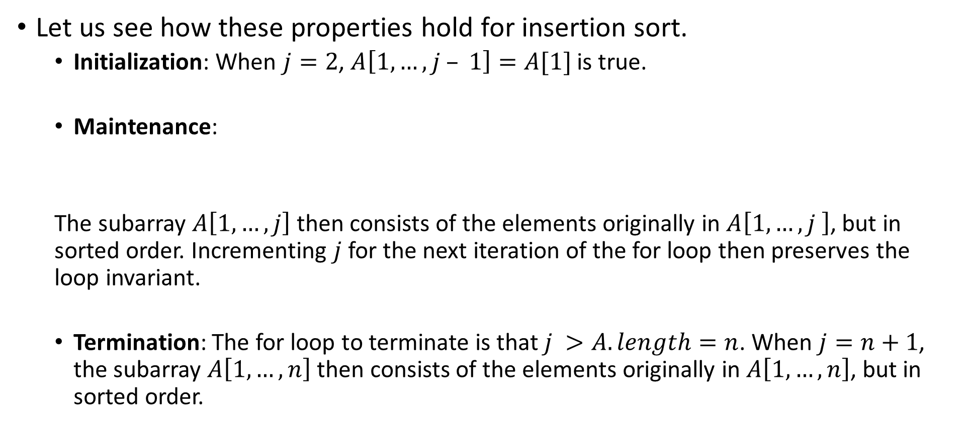
Let us see how these properties hold for insertion sort.
Initialization: When $j=2$, $A\left[1,…, j – 1\right]=A[1]$ is true.
Maintenance:
The subarray $A\left[1,…, j\right]$ then consists of the elements originally in $A\left[1,…, j \right]$, but in sorted order. Incrementing $j$ for the next iteration of the for loop then preserves the loop invariant.
Termination: The for loop to terminate is that $j >A.length=n$. When $j=n+1$, the subarray $A\left[1,…, n\right]$ then consists of the elements originally in $A\left[1,…, n\right]$, but in sorted order.
1 | 2 | 3 | 4 | 5 | 6
2 | 5 | 4 | 6 | 1 | 3

Slide 8
2.2 Analyzing algorithms
Analyzing an algorithm has come to mean predicting the resources that the algorithm requires.
Resources: memory, communication, bandwidth, logic gate, time.
Assumption: one processor, RAM
constant-time instruction: arithmetic (add, subtract, multiply, divide, remainder, floor, ceiling); data movement (load, store, copy); control (conditional and unconditional bramch, subroutine call and return)
Date type: integer and floating point
Limit on the size of each word of data

Slide 9
2.2 Analyzing algorithms
The best notion for input size depends on the problem being studied.
The running time of an algorithm on a particular input is the number of primitive operations or “steps” executed. It is convenient to define the notion of step so that it is as machine-independent as possible.

Slide 10
Analysis of insertion sort
Insertion-sort(A)
for j ← 2 to length[A]
do key ← A[j]
*Insert A[j] into the sorted
sequence A[1,…, j – 1]
i ← j – 1
while i > 0 and A[i] > key
do A[i + 1] ← A[i]
i ← i – 1
A[i + 1] ← key
t_{j}: the number of times the while loop test in line 5 is executed for the value of j.
cost
times
c₁
n
c₂
n – 1
0
c₄
n – 1
c₅
c₆
c₇
c₈
n – 1

Slide 11
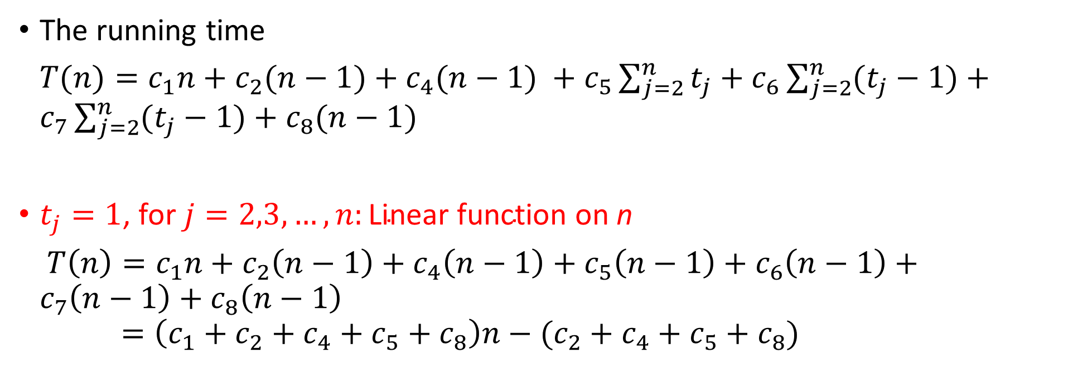
Analysis of insertion sort
The running time
$T(n)=c_{1}n+c_{2}(n−1)+c_{4}(n−1) +c_{5}\sum_{j=2}^{n}{t_{j}}+c_{6}\sum_{j=2}^{n}{(t_{j}−1)}+c_{7}\sum_{j=2}^{n}{(t_{j}−1)}+c_{8}(n−1)$
$t_{j}=1$, for $j=2,3,…,n:\text{Linear} \text{function} \text{on} \text{n}$
$T\left(n\right)=c_{1}n+c_{2}\left(n−1\right)+c_{4}\left(n−1\right)+c_{5}\left(n−1\right)+c_{6}\left(n−1\right)+c_{7}\left(n−1\right)+c_{8}\left(n−1\right)$ $=\left(c_{1}+c_{2}+c_{4}+c_{5}+c_{8}\right)n−(c_{2}+c_{4}+c_{5}+c_{8})$

Slide 12
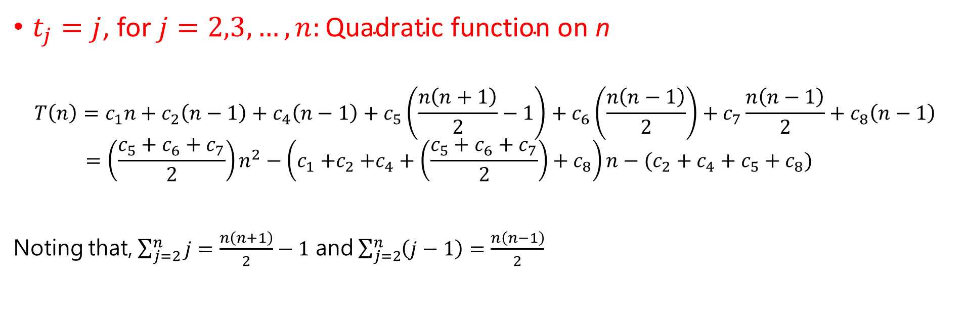
Analysis of insertion sort
$t_{j}=j$, for $j=2,3,…,n:\text{Quadratic} \text{function} \text{on} \text{n}$
$$T\left(n\right)=c_{1}n+c_{2}\left(n−1\right)+c_{4}\left(n−1\right)+c_{5}\left(\frac{n\left(n+1\right)}{2}−1\right)+c_{6}\left(\frac{n\left(n−1\right)}{2}\right)+c_{7}\frac{n\left(n−1\right)}{2}+c_{8}\left(n−1\right) \\ =\left(\frac{c_{5}+c_{6}+c_{7}}{2}\right)n^{2}−\left(c_{1}{+c}_{2}+c_{4}+\left(\frac{c_{5}+c_{6}+c_{7}}{2}\right)+c_{8}\right)n−(c_{2}+c_{4}+c_{5}+c_{8})$$
Noting that, $\sum_{j=2}^{n}{j}=\frac{n\left(n+1\right)}{2}−1$ and $\sum_{j=2}^{n}{\left(j−1\right)}=\frac{n\left(n−1\right)}{2}$

Slide 13
Worst-case and average-case analysis
Usually, we concentrate on finding only on the worst-case running time.
Reason:
It is an upper bound on the running time.
The worst case occurs fair often.
The average case is often as bad as the worst case. For example, the insertion sort. Again, quadratic function.

Slide 14
Order of growth
In some particular cases, we shall be interested in average-case, or expect running time of an algorithm.
It is the rate of growth, or order of growth, of the running time that really interests us.

Slide 15
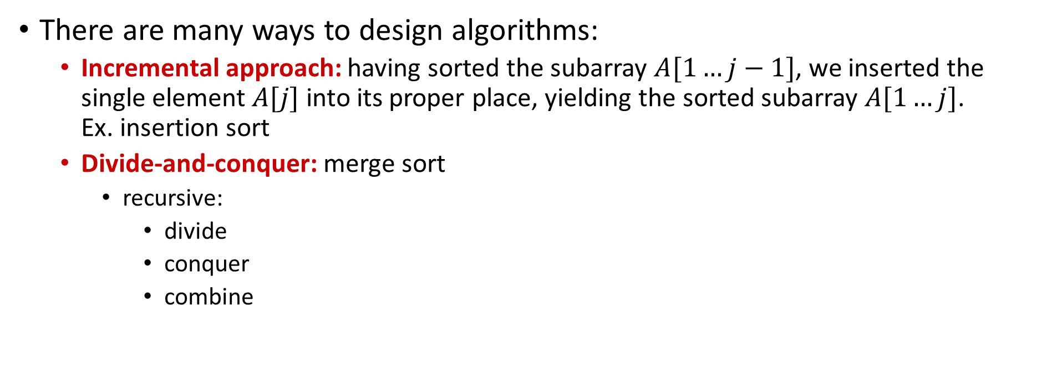
2.3 Designing algorithms
There are many ways to design algorithms:
Incremental approach: having sorted the subarray $A[1…j−1]$, we inserted the single element $A[j]$ into its proper place, yielding the sorted subarray $A[1…j]$. Ex. insertion sort
Divide-and-conquer: merge sort
recursive:
divide
conquer
combine

Slide 16
Pseudocode
Merge sort
Merge(A, p, q, r)
n₁ ← q – p + 1
n₂ ← r – q
create array L[1,…, n₁ + 1] and R[1,…, n₂ + 1]
for i ← 1 to n₁
do L[i] ← A[p + i – 1]
for j ← 1 to n₂
do R[j] ← A[q + j]
L[n₁ + 1] ← ∞
R[n₂ + 1] ← ∞

Slide 17
Pseudocode
i ← 1
j ← 1
for k ← p to r
do if L[i] ≤ R[j]
then A[k] ← L[i]
i ← i + 1
else A[k] ← R[j]
j ← j + 1

Slide 18
The operation of lines 10-17
 | 8 | 9 | 10 | 11 | 12 | 13 | 14 | 15 | 16 | 17
A | … | 2 | 4 | 5 | 7 | 1 | 2 | 3 | 6 | …
 |  | k
 | 1 | 2 | 3 | 4 | 5
L | 2 | 4 | 5 | 7 | ∞
 | i
 | 1 | 2 | 3 | 4 | 5
R | 1 | 2 | 3 | 6 | ∞
 | j
(a)

Slide 19
The operation of lines 10-17
 | 8 | 9 | 10 | 11 | 12 | 13 | 14 | 15 | 16 | 17
A | … | 1 | 4 | 5 | 7 | 1 | 2 | 3 | 6 | …
 |  |  | k
 | 1 | 2 | 3 | 4 | 5
L | 2 | 4 | 5 | 7 | ∞
 | i
 | 1 | 2 | 3 | 4 | 5
R | 1 | 2 | 3 | 6 | ∞
 |  | j
(b)

Slide 20
The operation of lines 10-17
 | 8 | 9 | 10 | 11 | 12 | 13 | 14 | 15 | 16 | 17
A | … | 1 | 2 | 5 | 7 | 1 | 2 | 3 | 6 | …
 |  |  |  | k
 | 1 | 2 | 3 | 4 | 5
L | 2 | 4 | 5 | 7 | ∞
 |  | i
 | 1 | 2 | 3 | 4 | 5
R | 1 | 2 | 3 | 6 | ∞
 |  | j
(c)

Slide 21
The operation of lines 10-17
 | 8 | 9 | 10 | 11 | 12 | 13 | 14 | 15 | 16 | 17
A | … | 1 | 2 | 2 | 7 | 1 | 2 | 3 | 6 | …
 |  |  |  |  | k
 | 1 | 2 | 3 | 4 | 5
L | 2 | 4 | 5 | 7 | ∞
 |  | i
 | 1 | 2 | 3 | 4 | 5
R | 1 | 2 | 3 | 6 | ∞
 |  |  | j
(d)

Slide 22
The operation of lines 10-17
 | 8 | 9 | 10 | 11 | 12 | 13 | 14 | 15 | 16 | 17
A | … | 1 | 2 | 2 | 3 | 1 | 2 | 3 | 6 | …
 |  |  |  |  |  | k
 | 1 | 2 | 3 | 4 | 5
L | 2 | 4 | 5 | 7 | ∞
 |  | i
 | 1 | 2 | 3 | 4 | 5
R | 1 | 2 | 3 | 6 | ∞
 |  |  |  | j
(e)

Slide 23
The operation of lines 10-17
 | 8 | 9 | 10 | 11 | 12 | 13 | 14 | 15 | 16 | 17
A | … | 1 | 2 | 2 | 3 | 4 | 2 | 3 | 6 | …
 |  |  |  |  |  |  | k
 | 1 | 2 | 3 | 4 | 5
L | 2 | 4 | 5 | 7 | ∞
 |  |  | i
 | 1 | 2 | 3 | 4 | 5
R | 1 | 2 | 3 | 6 | ∞
 |  |  |  | j
(f)

Slide 24
The operation of lines 10-17
 | 8 | 9 | 10 | 11 | 12 | 13 | 14 | 15 | 16 | 17
A | … | 1 | 2 | 2 | 3 | 4 | 5 | 3 | 6 | …
 |  |  |  |  |  |  |  | k
 | 1 | 2 | 3 | 4 | 5
L | 2 | 4 | 5 | 7 | ∞
 |  |  |  | i
 | 1 | 2 | 3 | 4 | 5
R | 1 | 2 | 3 | 6 | ∞
 |  |  |  | j
(g)

Slide 25
The operation of lines 10-17
 | 8 | 9 | 10 | 11 | 12 | 13 | 14 | 15 | 16 | 17
A | … | 1 | 2 | 2 | 3 | 4 | 5 | 6 | 6 | …
 |  |  |  |  |  |  |  |  | k
 | 1 | 2 | 3 | 4 | 5
L | 2 | 4 | 5 | 7 | ∞
 |  |  |  | i
 | 1 | 2 | 3 | 4 | 5
R | 1 | 2 | 3 | 6 | ∞
 |  |  |  |  | j
(h)

Slide 26
The operation of lines 10-17
 | 8 | 9 | 10 | 11 | 12 | 13 | 14 | 15 | 16 | 17
A | … | 1 | 2 | 2 | 3 | 4 | 5 | 6 | 7 | …
 |  |  |  |  |  |  |  |  |  | k
 | 1 | 2 | 3 | 4 | 5
L | 2 | 4 | 5 | 7 | ∞
 |  |  |  |  | i
 | 1 | 2 | 3 | 4 | 5
R | 1 | 2 | 3 | 6 | ∞
 |  |  |  |  | j
(i)

Slide 27
Pseudocode
MERGE-SORT(A, p, r)
if p < r
then q ← ⎣(p + r)/2⎦
MERGE-SORT(A, p, q)
MERGE-SORT(A, q + 1, r)
MERGE(A, p, q, r)

Slide 28
The operation of Merge sort
sorted sequence
initial sequence
1 | 2 | 2 | 3 | 4 | 5 | 6 | 7
5 | 2 | 4 | 7 | 1 | 3 | 2 | 6
merge
2 | 4 | 5 | 7
1 | 3 | 2 | 6
5 | 2 | 4 | 7
1 | 2 | 3 | 6
merge
merge
2 | 6
2 | 5
4 | 7
2 | 6
4 | 7
1 | 3
5 | 2
1 | 3
merge
merge
merge
merge
5
2
4
7
1
3
2
6

Slide 29
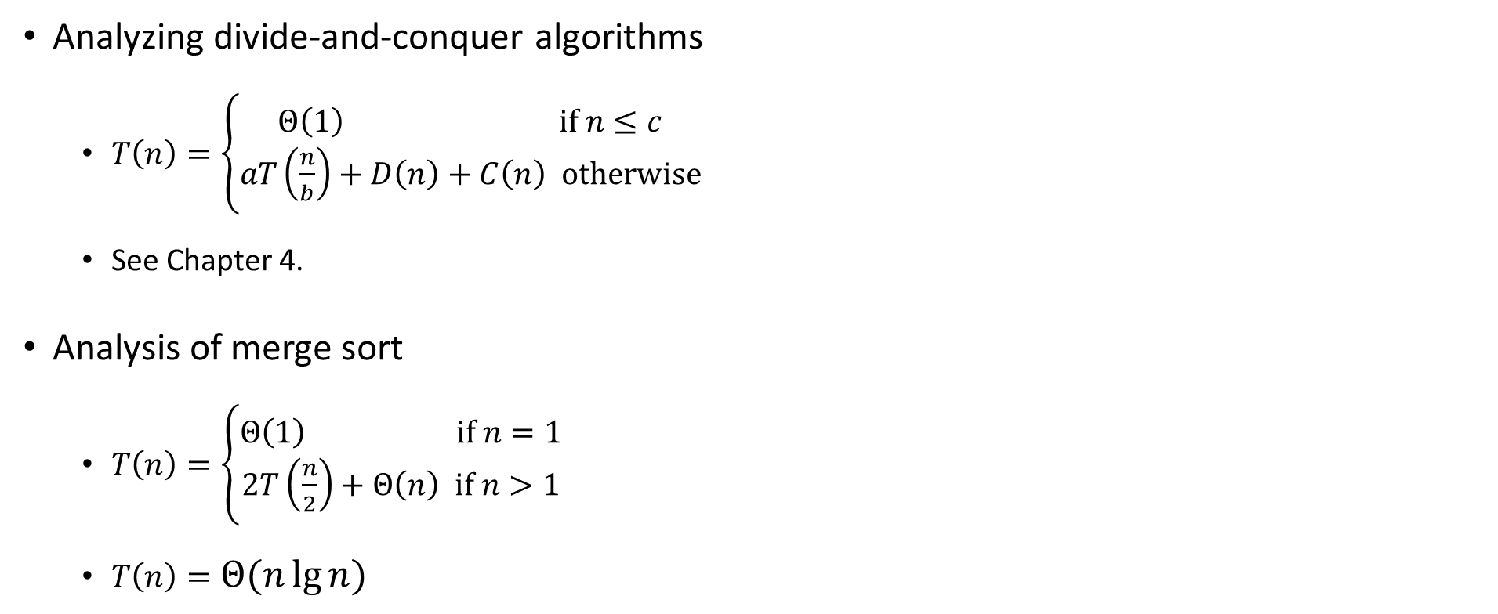
Analysis of Merge sort
Analyzing divide-and-conquer algorithms
$T\left(n\right)=\left\{\begin{matrix}Θ\left(1\right) if n≤c \\ aT\left(\frac{n}{b}\right)+D\left(n\right)+C\left(n\right) otherwise\end{matrix}\right.$
See Chapter 4.
Analysis of merge sort
$T\left(n\right)=\left\{\begin{matrix}Θ\left(1\right) if n=1 \\ 2T\left(\frac{n}{2}\right)+Θ\left(n\right) if n>1\end{matrix}\right.$
$T\left(n\right)=Θ(n\lg{n})$

Slide 30
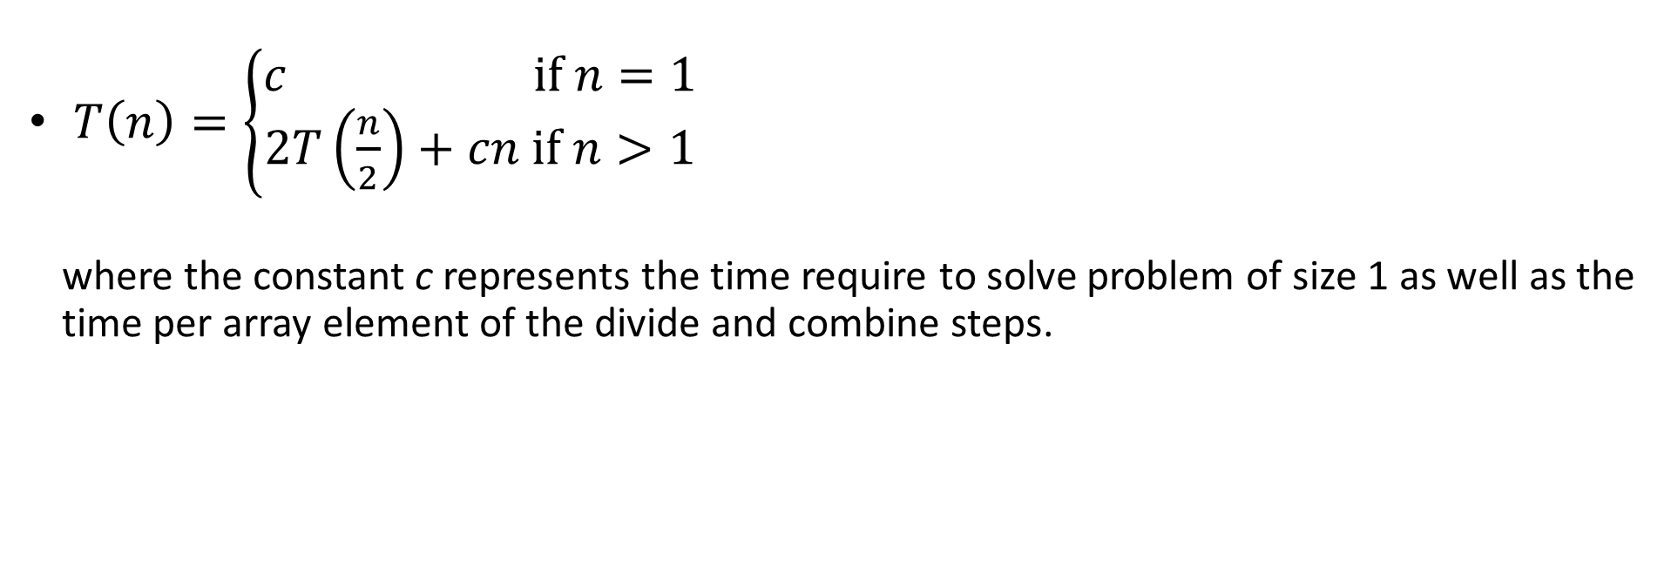
Analysis of Merge sort
$T\left(n\right)=\left\{\begin{matrix}c if n=1 \\ 2T\left(\frac{n}{2}\right)+cn if n>1\end{matrix}\right.$
where the constant c represents the time require to solve problem of size 1 as well as the time per array element of the divide and combine steps.

Slide 31

The construction of a recursion tree
T(n)
cn
cn
(a)
c(n/2)
c(n/2)
cn
cn
lg n
c(n/4)
c(n/4)
c(n/4)
c(n/4)
cn
T(n/2)
T(n/2)
(b)
c
c
c
c
c
c
c
c
cn
cn
n
Total: cn lg n + cn
c(n/2)
c(n/2)
(d)
The fully expanded tree in part (d) has $\lg{n}+1$ levels (i.e., it has height $\lg{n}$, as indicated)
T(n/4)
T(n/4)
T(n/4)
T(n/4)
(c)

Slide 32
Outperforms insertion sort!

